Slide 1


Introduction to Network
SE3331-1 (2022 Fall)
IPADS, Shanghai Jiao Tong University
https://www.sjtu.edu.cn

Slide 2
Review: scalable websites
Scalable websites powered by distributed systems
For request handling, data storage
Caching server
Caching server
Caching server
…
Caching
Caching
Caching
Distributed caching
Database server
Database server
CDN
Users
Application #1
generate the page
Database
user, price
…
Database
user, price
Application server
Distributed database
Internet
Load
Balance
Application #2
add the order
File server
File server
File server
File:
image
File:
image
…
File:
image
Application server
…
…
Message queue
Distributed file system

Slide 3
Layers in Network
link layer:(P2P),传递效率取决于传输介质
network layer:更关注data transfer以及路由,更关注算法层面,即
如何传输等,但是不会处理传输过程中问题,如丢包,断网等
end-to-end layer:会处理出问题的情况,即根据语义选择合适的at-least-once/at-most-once
Application
Can be thought of as a fourth layer
Not part of the network
End-to-end layer
Everything else required to provide a comfortable application interface
Network layer
Forwarding data through intermediate points to the place it is wanted
Link layer
Moving data directly from one point to another

Slide 4
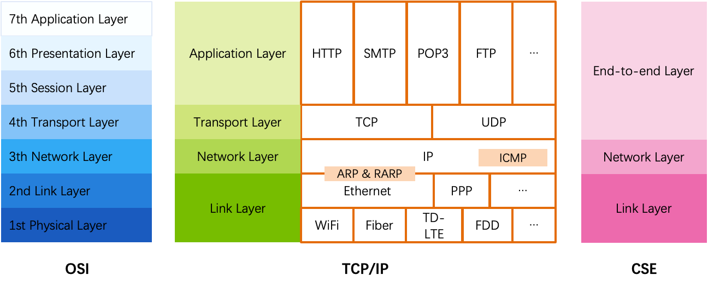
OSI, TCP/IP & Protocol Stack
ICMP:用于诊断网络,通过ping的方式
ethernet：48位 IPV4：32位
IPV6:64位 ethernet<-->IP
一台机器上面最多同时开放65535个ports
port位于end-to-end层
OSI
The open systems interconnection (OSI) model
7-layer architecture

Slide 5
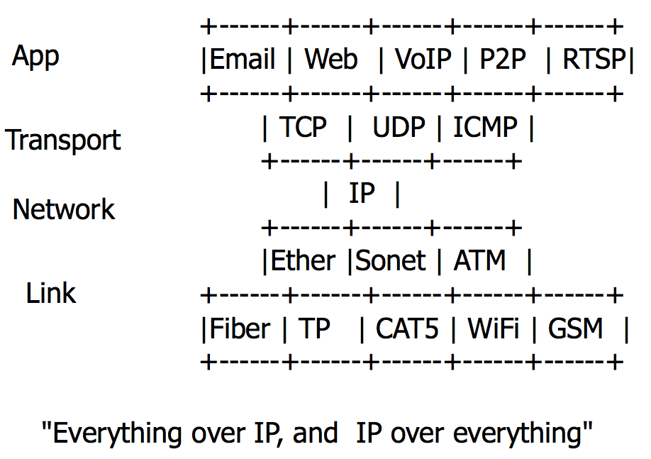
The Internet "Hour Glass" Protocols
More people, more useful
Value to me = N
Value to society is N²
Network, dumb vs. smart
Standardize vs. flexibility
Network is a black box
Simplify the system that uses it

Slide 6
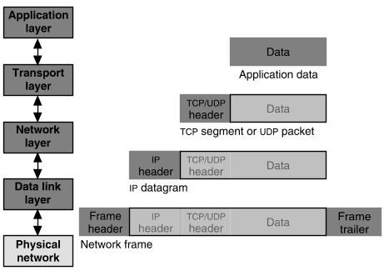
Packet Encapsulation
22Bytes
20Bytes
20Bytes
4Bytes
64 to 1500 Bytes
Notes:
注意内存的布局

Slide 7


Application Layer
Entities
Client and server
End-to-end connection
Name space: URL
Protocols
HTTP, FTP, POP3, SMTP, etc.
What to care?
Content of the data: video, text, …
<html>
<head>
<title>Google</title>
<script>window.google=…..
</script>
</head>
<body> … </body>
</html>

Slide 8

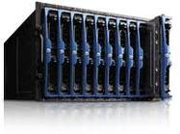
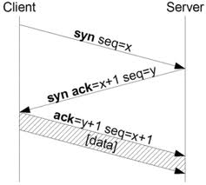
Transport Layer
Entities
Sender and receiver
Proxy, firewall, etc.
End-to-end connection
Name space: port number
Protocols: TCP, UDP, etc.
What to care?
TCP: Retransmit packet if lost
UDP: nothing

Slide 9
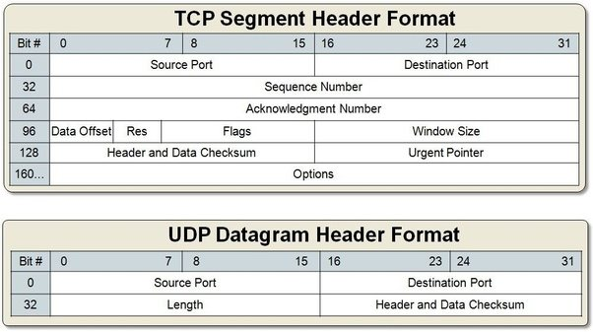
Packet Format of TCP & UDP

Slide 10
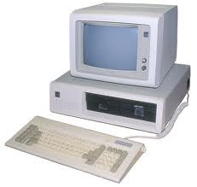
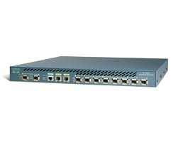
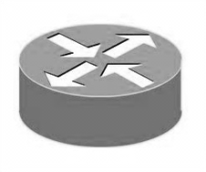
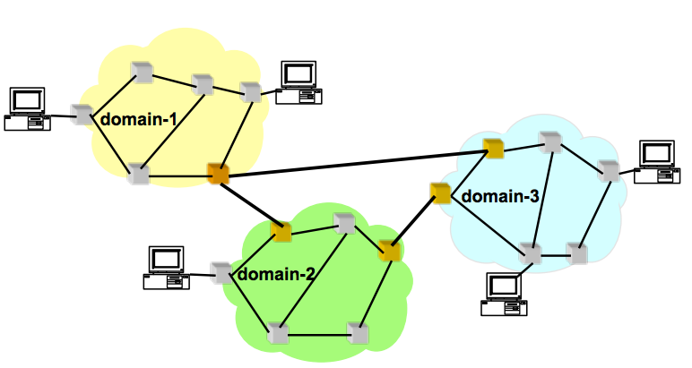
Network Layer (the Internet Layer, IP Layer)
Network entities
Gateway(网关), bridge
Router, etc.
Name space
IP address
Protocols
IP, ICMP (ping,ping是在kernel完成)
What to care?
Next hop decided by route table
network layer内部存储有一个route table，这个table是存储的是节点之间的拓扑结构。在进行通信的时候，要选择最短并且跳转尽量最少的那条路径(最短可靠路径)但是没有一个机器可以存储所有的节点，因而就引入了在进行网络连接时可能无法连接的问题

Slide 11
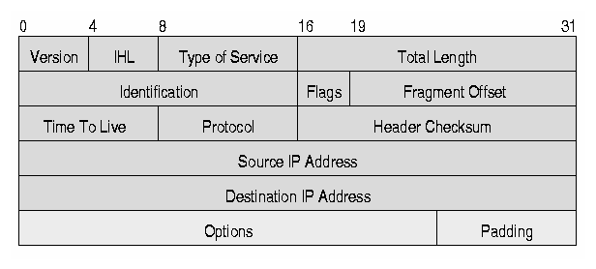
IP Datagram (Packet, Package)
Header
10101011101010101010010101010100101010100
11010010101010010101111111010000011101111
10100001011101010100110101011110100000101
00100000000010101000011010000111111010101
......... 1011011001010100011001001010110
Data

Slide 12
TCP/IP Architecture
Machine A
Machine B
Application
Application
Transport
Router/Gateway
Transport
Internet
Internet
Internet
Network Interface
Network Interface
Network Interface
Network 1
Network 2

Slide 13
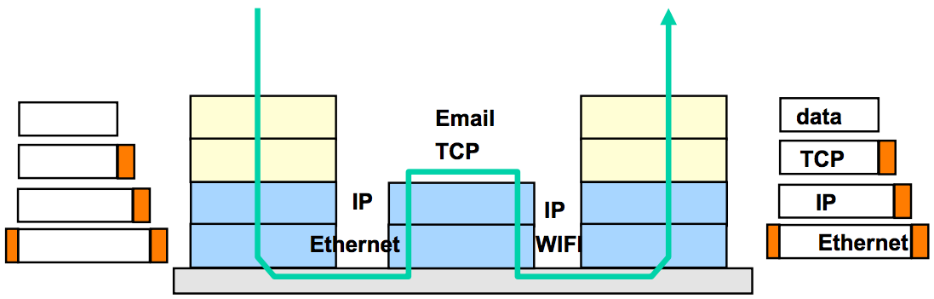
TCP/IP Architecture
Each layer adds/strips off its own header
Each layer may split up higher-level data
Each layer multiplexes multiple higher layers
Each layer is (mostly) transparent to higher layers

Slide 14
Link Layer
From a node to its physical neighbor

Slide 15
The Link Layer
The bottom-most layer of the three layers
Purpose: moving data directly from one physical location to another
1. Physical transmission
2. Multiplexing the link
3. Framing bits & bit sequences
4. Detecting transmission errors
5. Providing a useful interface to the up layer

Slide 16
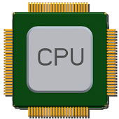
Physical Transmission using Shared Clock
Example-1: moving a bit from register-1 to register-2 on the same chip
Run a wire to connect output of reg-1 to input of reg-2
Wait till reg-1's output has settled & signal has propagated to reg-2
Reg-2 read input the next clock tick
Assumption: propagation can be done within one clock
How to send data between two modules without sharing a clock?

Slide 17
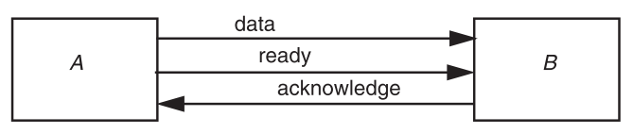
Physical Transmission without Shared Clock
Three-wire ready/acknowledge protocol(三线协议)
1. A places data on data line
2. A changes value on the ready line
B sees the ready line change, reads value on the data line, then changes the acknowledge line
B: when to look at the data line? (ready is set)
A: when to stop holding the bit value on the data line? (ack is set)
三线协议流程：A将ready设置为0，A将data设置为在data line上面，A同时将ready设置为1，之后B在检测到ready变为1之后就通过data line读取数据，之后将ac line设置为1，A在检测到ac line变为1之后，将ready设置为0，从而进入新的数据通信的循环

Slide 18
Parallel Transmission
一个U盘有四个触点，2个用作电源，2个用作数据传输
Propagation time ∆t
It takes more than 2x∆t to send one bit
The max data rate is 1/(2∆t)(recall:课件1上面讲的那个ethernet传输网络包最小包头的例子)
Parallel transmission
Use N parallel data lines to achieve N/(2∆t)
E.g., SCSI, printer, etc.

Slide 19
Serial Transmission
Ready/acknowledge protocol
∆t grows significantly, which limits the data rate
Serial transmission
Send a stream of bits down a single line
Without waiting for any response from the receiver
Expect the receiver can recover the bits with no additional signal
Higher rates, longer distance, fewer wires
E.g., USB, SATA

Slide 20
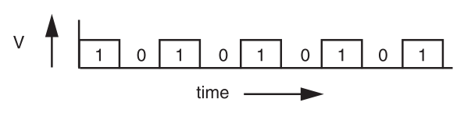
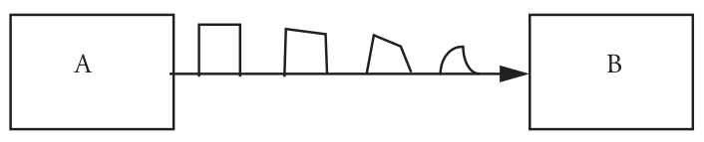
Signal Transmission on Analog Line
It is hard for B to understand the signal
B doesn't have a copy of A's clock, so when to sample the signal?

Slide 21
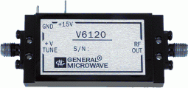
VCO: Voltage Controlled Oscillator
How to make two ends agree on the data rate without clock line?
The receiver run a VCO at about the same data rate
VCO's output is multiplied by the voltage of incoming signal
The product is suitably filtered and sent back to adjust the VCO
VCO will finally be locked to both the frequency and phase of the arriving signal: phase-locked loop
Then the VCO becomes a clock source for the receiver
Problem: if no transition in the stream (e.g., a lot of zero), the phase-locked loop cannot synchronize-->所以需要一种方式来避免这种情况，即连续数据无法识别数量的问题

Slide 22
Manchester Code(曼彻斯特编码)
Solution: sender encodes the data to ensure transitions
Phase encoding: at least 1 level transition for a bit
Manchester code: 0 -> 01, 1 -> 10
Max data rate is only half, but simple enough
1
0
1
0
1
1
1
0
0
Polar NRZ
Manchester
Encoding

Slide 23
How to Share a Connection?
Isochronous communication(同步通信) (telephone communication)
Needs prior arrangement between switches
Connection: set up and tear down
Stream: continuous bits flows out of a phone
Asynchronous communication(异步通信) (data communication)
Message: burst, ill-suited to fixed size and spacing of isochronous frames
Connectionless, asynchronous

Slide 24
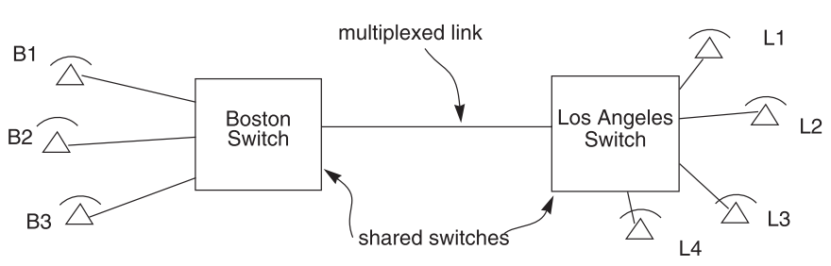
Isochronous Multiplexing
Telephone network
Leverage "virtual link" for connection
"network is busy" when no available time slot

Slide 25
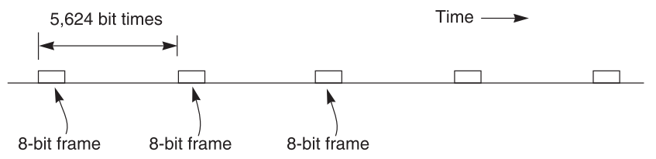
Isochronous - TDM
64 Kbps each phone, 45 Mbps link
8-bit block (frame), 8000 frames per second
5624 bit times or 125 us
703 simultaneous conversations (what if there is a 704th calling?)
Q: Why the voice is still continuous, instead of fragmented?
问题:主要是可能产生较大的资源浪费，即如果建立了通信但是没有传输数据，那么会浪费 64KB的资源空间
据说人耳朵能自动补全？！

Slide 26
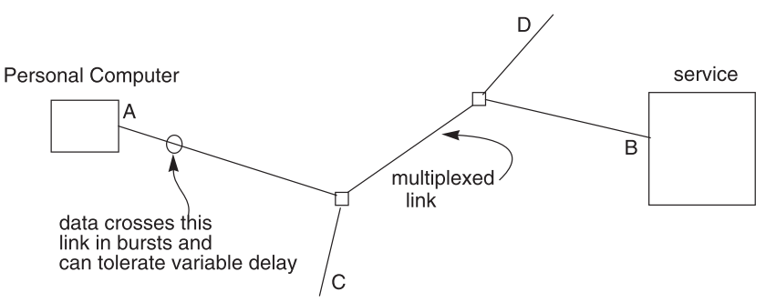
Data Communication Network
Data communication network usually contains burst communication
Different from the telephone network
因为不会向同步通信那样预留空间，所以可能每次数据传输长度不一样，所以需要同时记录header和tailer

Slide 27
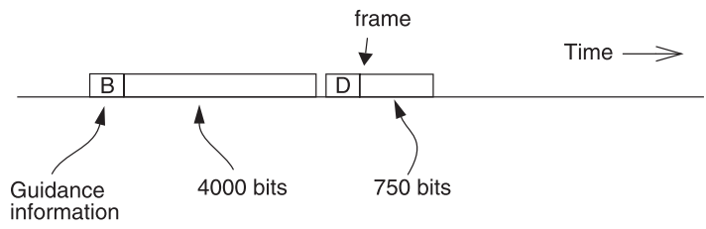
Frame and Packet: Asynchronous Link
Frame can be of any length, carried at any time that the link is free
Packet: a variable-length frame with its guidance info(记录要发给哪一个node)
Connectionless transmission: no state maintained
Segment and reassemble
Packet voice: replacing many parts of isochronous network

Slide 28
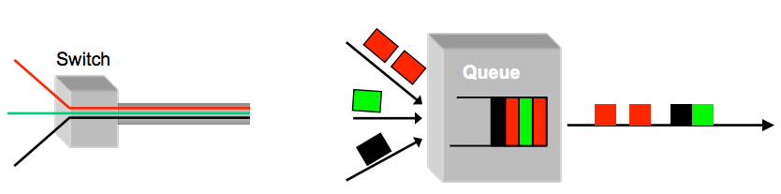
Multiplexing / Demultiplexing
Multiplex using a queue: switch need memory/buffer
Demultiplex using information in packet header
Header has destination(即guide info)
Switch has a forwarding table that contains information about which link to use to reach a destination

Slide 29
Framing Frames
Where a frame begins and ends
Independent from framing bits
Some model separates link layer to 2: one for bits and one for frames
Simple method(用于识别一个frame的结束/开始)
Choose a pattern of bits, e.g., 7 one-bits in a row, as a frame-separator
Bit stuffing: if data contains 6 ones in a row, then add an extra bit (0)

Slide 30
Error Handling
Error detection code
Adding redundancy: e.g., checksum at the end
What to do if detect an error
Error correction code: with enough redundancy
Where noise is well understood, e.g., disk
Ask sender to resend: sender holds frame in buffer
Let receiver discard the frame
Blending these techniques

Slide 31


Coding: Incremental Redundancy
Forward error correction
Perform coding before storing or transmitting
Later decode the data without appealing to the creator
Hamming distance
Number of 1 in A ⊕ B , ⊕ is exclusive OR (XOR)
If H-distance between every legitimate pair is 2
000101, can only detect 1-bit flip
If H-distance between every legitimate pair is 3
Can only correct 1 bit flip
If H-distance between every legitimate pair is 4
Can detect 2-bit flip, correct 1-bit flip

Slide 32
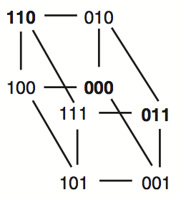
Example-1: Simple Parity Check
2 bits -> 3 bits
Detect 1-bit errors
8 patterns total
Only 4 correct patterns
00 -> 000
11 -> 110
10 -> 101
01 -> 011
Hamming distance of this code is 2
1-bit flipping will cause incorrect pattern
P1=P2⊕P3
P2=P1⊕P3
所以当一位出错的时候一定是另外两位中的一个出错了。而两个都取反的时候还是正确的，因而汉明距离为2.
需要注意这个第三位应该是计算出来的，而不是真正传递过来的数据

Slide 33
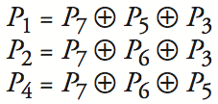
Example-2: 4-bit -> 7-bit
4 bits -> 7 bits (56 using only extra 7)
3 extra bits to distinguish 8 cases(这三个额外的
bits不是传递过来的数据，而是额外计算的)
e.g. 1101 -> 1010101
Correct 1-bit errors
1010101 -> 1010001 : P1 & P4 not match
1010101 -> 1110101 : P2 not match
Not Match | Error
None | None
P1 | P1
P2 | P2
P4 | P4
P1 & P2 | P3
P1 & P4 | P5
P2 & P4 | P6
P1 & P2 & P4 | P7
1 2 3 4 5 6 7
1
0
1
0
1
0
1
1
0
1
0
1
0
1
1
0
1
0
1
0
1
1+2+4 = 7！

Slide 34
Network Layer

Slide 35
IP: Best-effort Network
1. Best-effort network
If it cannot dispatch, may discard a packet
2. Guaranteed-delivery network
Also called store-and-forward network, no discarding data
Work with complete messages rather than packets
Use disk for buffering to handle peaks
Tracks individual message to make sure none are lost
In real world
No absolute guarantee
Guaranteed-delivery: higher layer; best-effort: lower layer

Slide 36
Duplicate Packets and Suppression
Discarding packets is common case
Many network protocol includes timeout and resend mechanism
When a congested forwarder discards a packet
Client does not receive a response as quickly as originally hoped
Users may prepared for duplicate requests and responses
Detecting duplicates may or may not be important

Slide 37
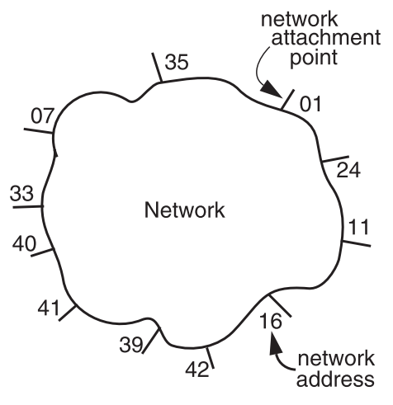
The Network Layer
Addressing interface
Network attachment points
Network address
Source & destination
NETWORK_SEND (segment_buffer, destnation, network_protocol, end_layer_protocol)
NETWORK_HANDLE (packet, network_protocol)

Slide 38


Managing the Forwarding Table: Routing
Routing (or path-finding)
Constructing the tables
Impractical by hand
Determining the best paths requires calculation
Recalculating the table when links change
Recalculating the table when link fails
Adapt according to traffic congestion
Static routing vs. adaptive routing
Adaptive routing requires exchange of info
Where are you going?

Slide 39
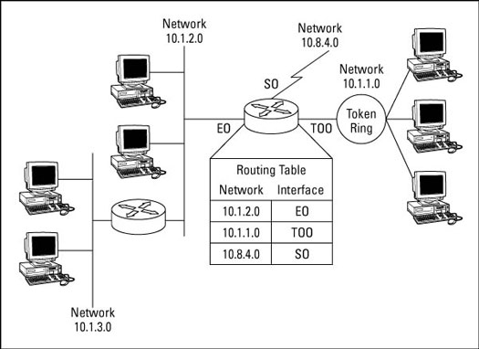
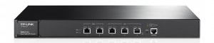
IP Route Table
Interface 1 … Interface N

Slide 40
Control-plane VS. Data-plane
Control-plane
Control the data flow by defining rules
E.g., the routing algorithm
Data-plane
The data-path which copies data according to the rules
Performance critical
E.g., the IP forwarding process
write
read
routing table
Notes:
The
Control-plane the table, data-plane reads the table

